Slide 1

Sir M Visvesvaraya Institute Of Technology
Department Of Computer Science & Engineering
Technical Seminar entitled
“Semantic Documents Relatedness using Concept Graph Representation”
Amit Asish Bhadra 1MV13CS014
Karan Saxena 1MV13CS047

Slide 2
ABSTRACT
Semantic Relatedness and its need
Existing Semantic Models(LSA, LDA, Word2Vec, Doc2Vec)
Knowledge Base like Wikipedia to supply us with concept vectors

Slide 3
CONTENTS
Introduction
Technical Description
Applications
Conclusion
References

Slide 4
INTRODUCTION
Overview
History

Slide 5
OVERVIEW
Bag of Words
Latent Topics
Latent Semantic Analysis(LSA)
Latent Dirichlet Allocation(LDA)
Word2Vec
Our Model builds on the advantages of all these:
Uses Topic Models based on explicit concepts
Relationships among concepts
Neural Net to represent concepts as continuous vectors

Slide 6
HISTORY
PreProcessing of Text
Get a sentence
Tokenize each word
Lemmatize each token
The result is a set of terms corresponding to the input document. We can use:
Boolean Model
Term Frequency
Logarithmically scaled term frequency
Augmented Frequency
External Linguistic Models which has free APIs
WordNet

Slide 7
BAG OF WORDS
A text is represented as the bag (multiset) of its words, disregarding grammar and even word order but keeping multiplicity.
Is used in computer vision.
Occurrence of each word is used as a feature for training a classifier.
A tool for feature extraction.

Slide 8
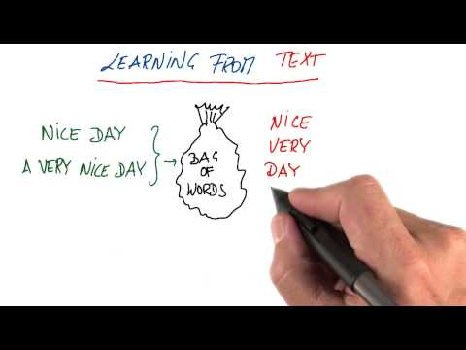

Slide 9
TECHNICAL DESCRIPTION
Tf-Idf
LSA
LDA
Word2Vec
Doc2Vec
Concept2Vec

Slide 10
Tf-Idf
Term Frequency Inverse Document Frequency.
It is a numerical constant which reflects how important a word is to a document or a corpus.
Uses:
Used by search engines as a central tool in scoring and ranking a document's relevance.
Used for filtering stop words in various subject fields including text summarization and classification(Examples of stop words are- “I want” in a search query such as-”I want to know the population of India”)

Slide 11
Tf-Idf DEFINITIONS
Term Frequency tf(t,d)
The raw count of a term in a document, ie , the number f times that term t occurs in a document d.
If we denote the raw count by f_{t,d} then the simplest tf scheme is tf(t,d) = f_{t,d}
Other schemes can be boolean scheme frequency, logarithmic scheme frequency, augmented frequency, etc
Example: There are 2 documents (d1 and d2), and each document has some words. The word “this” is repeated only once in document d1. There are in total 5 words in d1. Hence, we have tf(“this”, d1) = ⅕ = 0.2

Slide 12
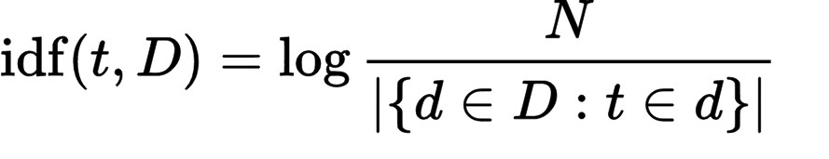
Tf-Idf DEFINITIONS (contd)
Inverse Document Frequency idf(t, D)
A measure of how much information the word provides, that is, whether the term is common or rare across all documents.
It is the logarithmically scaled inverse fraction of the documents that contain the word, obtained by dividing the total number of documents by the number of documents containing the term, and then taking the logarithm of that quotient.
Where:
N : total number of documents in the corpus N = | D |
| { d ∈ D : t ∈ d } | : number of documents where the term t appears (i.e., t f ( t , d ) ≠ 0 ).

Slide 13
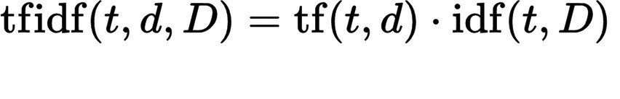
Tf-Idf DEFINITIONS (contd)
Term frequency–Inverse document frequency is calculated as:
Example of tf-idf: tf(“example”, d2) = 3/7 = 0.429 idf(“example”, D) = log(2/1) = 0.301
Then, tf-idf(“example”, d2) = 0.429 * 0.301 = 0.13
d1 d2
Term | Count
this | 1
is | 1
a | 2
sample | 1
Term | Count
this | 1
is | 1
another | 2
example | 3

Slide 14
LSA
Latent Semantic Analysis
A method for extracting and representing the contextual meaning of words by statistical computations performed on a corpus of documents.
The underlying idea is that the totality of information about all the word contexts, in which a given word does and does not appear, provides a set of mutual constraints that largely determines the similarity of meaning of words.
We not only search for the word, but all other words in the document which have some relative meaning, or is a synonym to the main word.
This is used by Google as a part of their page ranking algorithm.

Slide 15
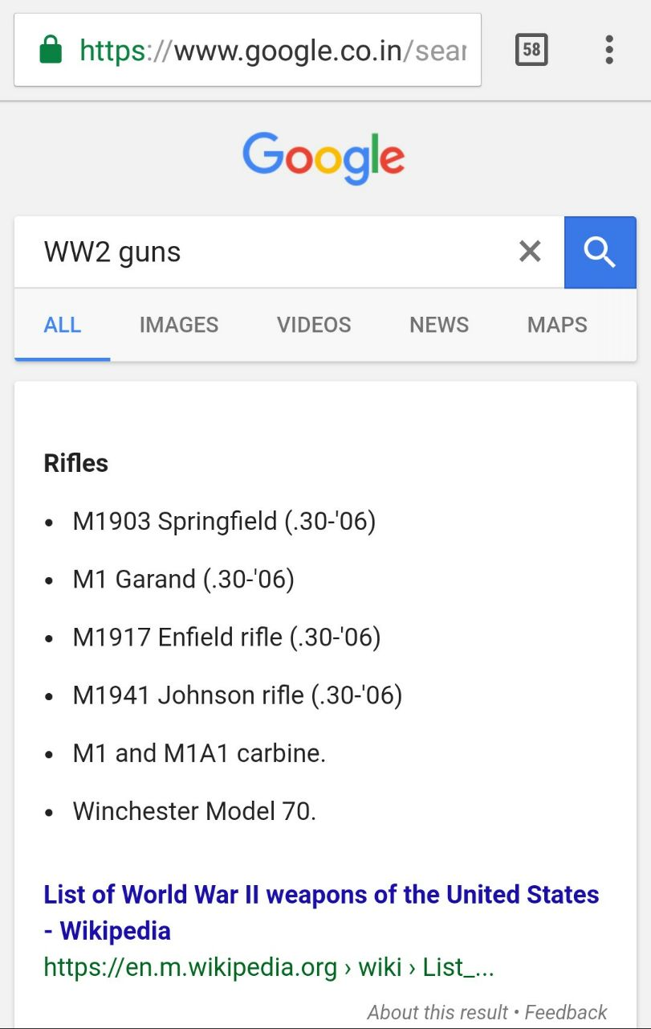
When we search for WW2 Guns, Google shows us search results for World War 2 Guns because in the millions of articles, WW and World War are found together, not because it is the abbreviation of the other.

Slide 16
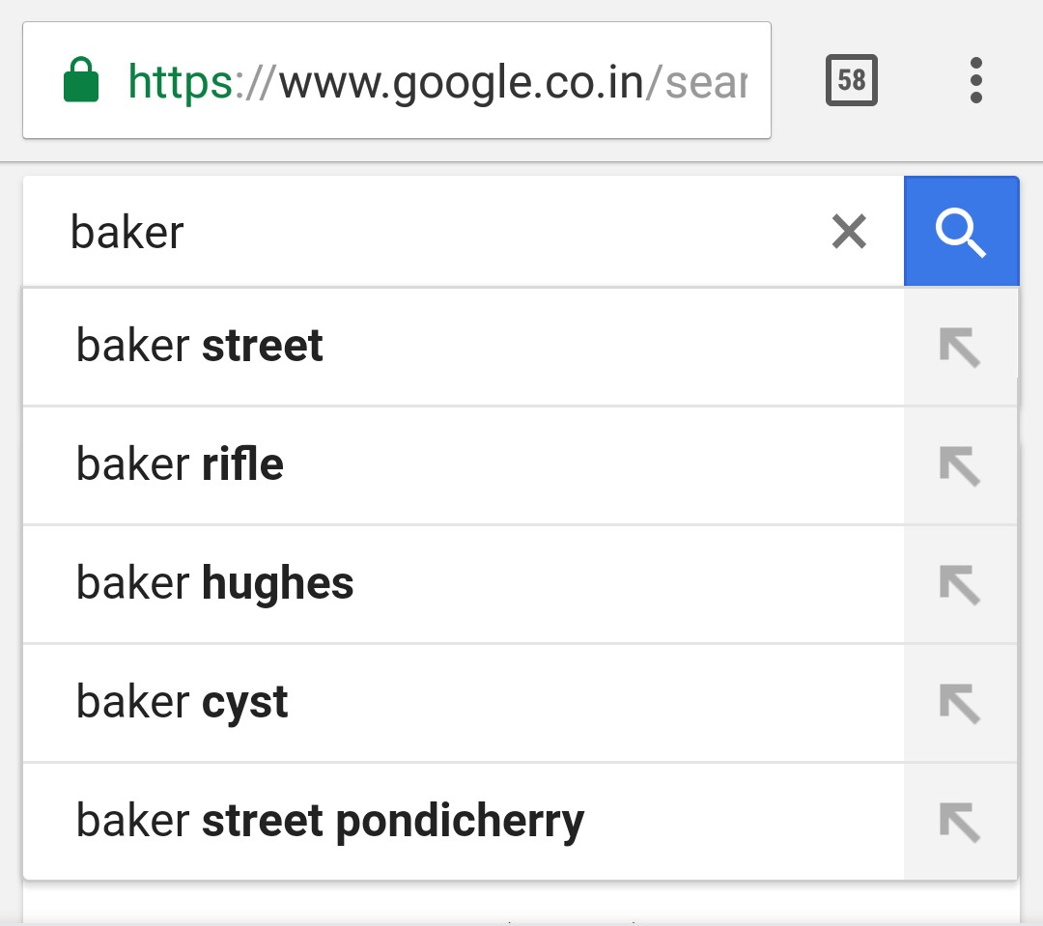
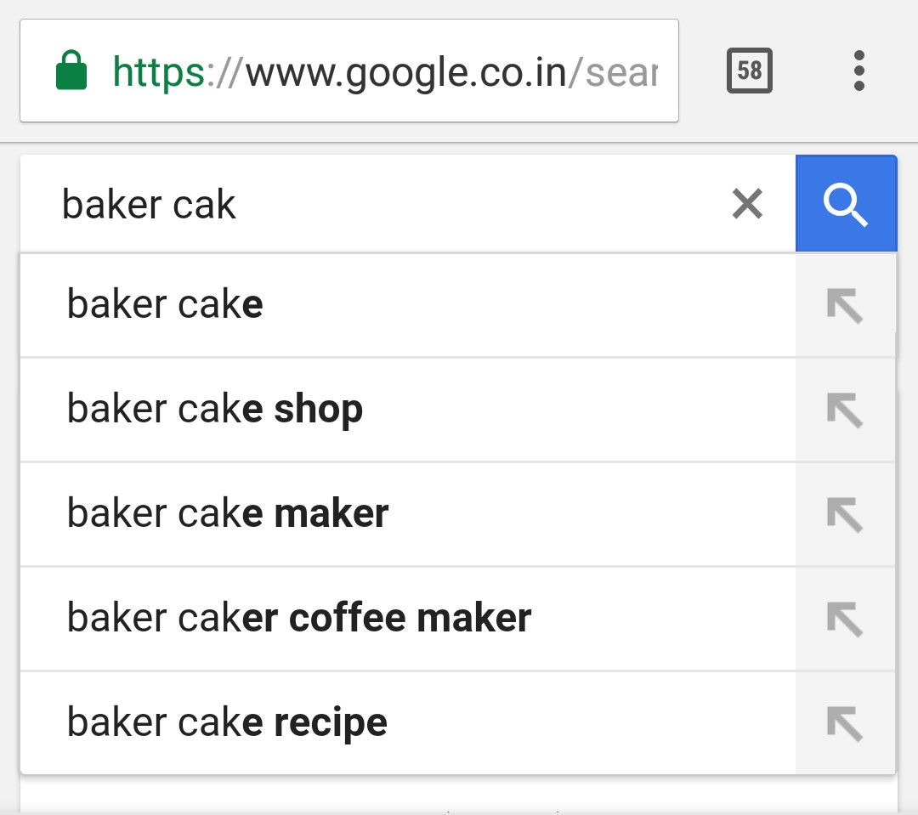
Fig 1: Google “baker” Fig 2: Google “baker cak”

Slide 17
LSA contd
Baker
Street
Sherlock
Watson
Detective
Baker
Cake
Pastry
Sweet
Bread
Fig 1: Google “baker” Fig 2: Google “baker cak”

Slide 18
LDA
Latent Dirichlet Allocation
A model which breaks down the collection of documents into topics by representing the document as a mixture of topics with their probability distributions.
The topics are represented as a mixture of words with a probability representing the importance of the word for each topic.
The distribution is such that Words(1..n) -> Documents(1..n) -> Dataset
Since LDA provides probability distributions of topics, it is possible to use statistical measures for quantifying the similarity between 2 documents.
The generative process is as follows:
Randomly choose a distribution over topics
Probabilistically draw one of the K topics from the distribution over topics
measures for quantifying the similarity between two documents.

Slide 19
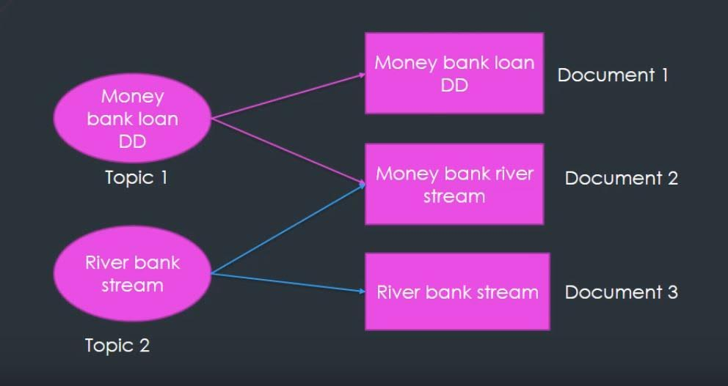
LDA contd
The goal of LDA is to automatically choose a word and correctly guess it’s topic.

Slide 20
Word2Vec
Word2Vec is a two-layer neural net published by Google in 2013.
It implements continuous bag-of-words and skip-gram architectures for computing vector representations of words.
The output of Word2Vec is a vocabulary of words, which appear in the original document, along with their vector representations in an n-dimensional vector space.
Related words and/or groups of words appear next to each other in this space.

Slide 21
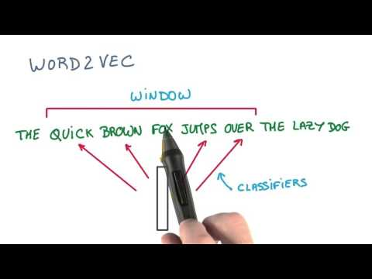

Slide 22
Word2Vec contd
Since Word2Vec provides vector representations only for words, we need to combine them in some way to get a representation of the whole document.
This can be done by averaging all the word vectors for the given document, and thus creating just one document vector, which can be compared to another by cosine similarity.
We usually normalise the vectors before finding the cosine between them because we are not interested in their lengths, but how near or far they are located to each other.

Slide 23
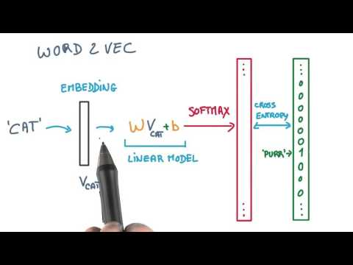

Slide 24
Doc2Vec
Google’s Word2Vec project has created lots of interests in the text mining community.
It provides high quality word vectors, however there is still no clear way to combine them into a high quality document vector.
Doc2Vec (Paragraph2Vec) modifies the Word2Vec model into unsupervised learning of continuous representations for larger blocks of text, such as sentences, paragraphs or entire documents.
Paragraph Vector is used on the IMDB dataset to produce some of the most state-of-the-art results to date.

Slide 25



TRANSPORT + WATER = BOAT or SHIP
+ =

Slide 26
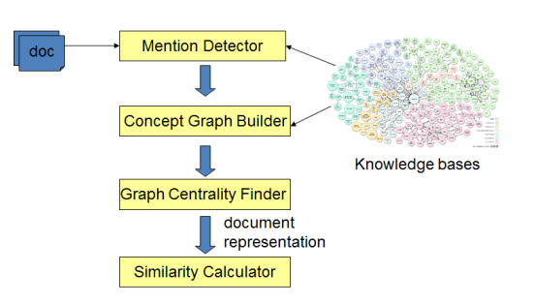
Concept2Vec

Slide 27
APPLICATIONS
Theoretical Applications
Practical Applications
Example Applications

Slide 28
THEORETICAL APPLICATIONS
Preserves the word ordering and semantic relationships between words.
Improves upon previous CBOW (Continuous Bag of Words) and Skip-Gram Models.
Can be restricted in terms of dimensions.

Slide 29
PRACTICAL APPLICATIONS
Can be used to generate word embeddings. These embeddings can be used to build intelligent machines based on the hypothesis that ‘background knowledge is the key to intelligent decision making’.
Can be used to build large scale recommender systems. These recommender systems are arguably better than Collaborative Filtering Models that suffer from ‘cold-start’ problem.
Provides a contextual learning platform which can further be extrapolated to encompass any kind of ‘domain-specific’ contextual learning in a short period of time.

Slide 30
EXAMPLE APPLICATIONS
The Hospital Training Model

Slide 31
CONCLUSION
DBPedia to explore relationships among the detected concepts and weighs.
ConceptGraphSim between two documents by comparing their concept graphs.
For future work, we can add more features and improve the quality of the concept graph representation by either improving the accuracy of the mention detection tool or enriching the concept graph with additional related concepts from the knowledge base.

Slide 32
REFERENCES

